Slide 1
What Google Trends
Tell Us
Group 12:
Zhaoru Shang
Tushar Dobhal
Xiaolong He
Manjot Bilkhu
Tianjun Huang

Slide 2
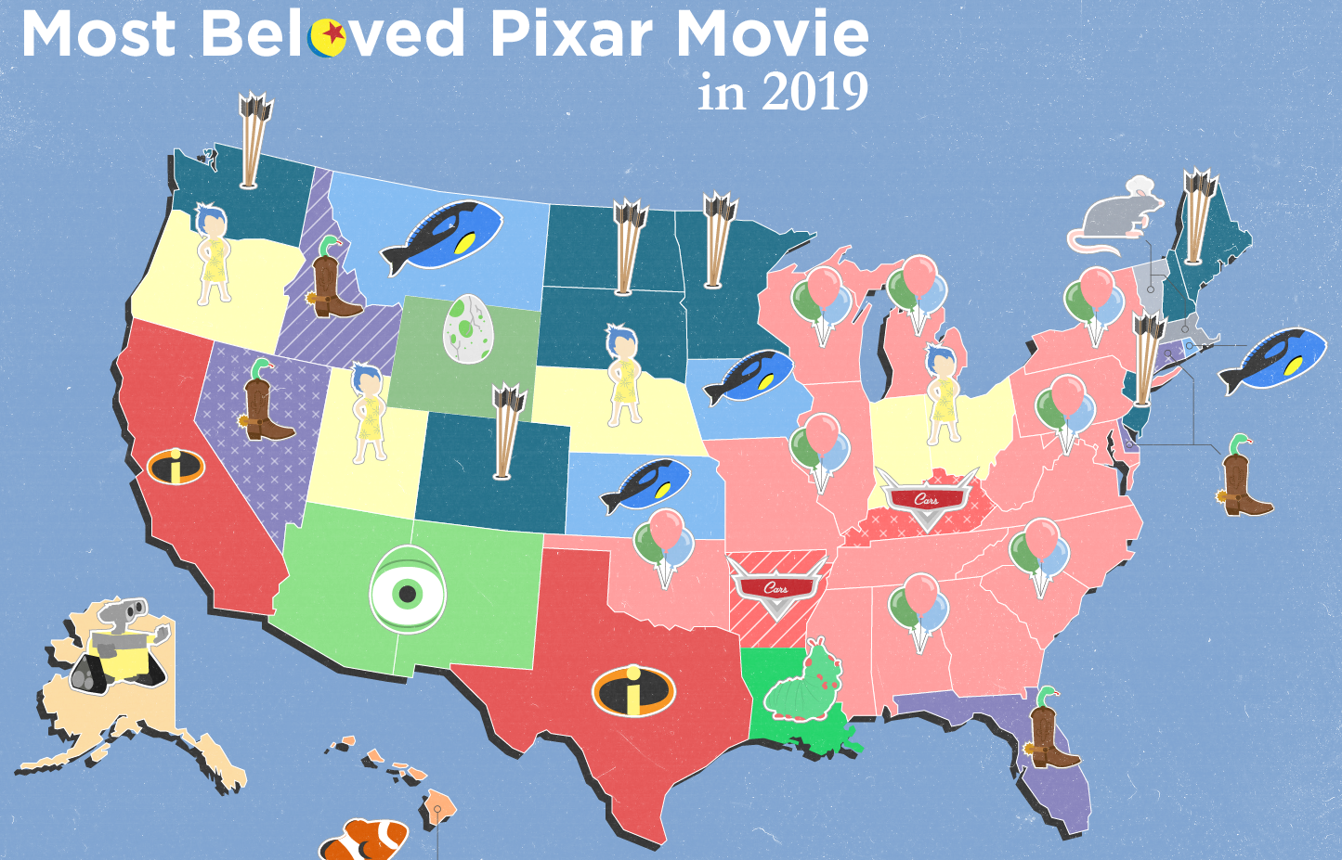
Motivation
Notes:
While searching for topics, we came across this, which used Google Trends. ThIs was done by the Entertainment Weekly So we thought to investigate, how true this figure is to the real world. Or better still, can google trends relate to any real world quantifiable metric

Slide 3
Motivation
Interest
Google Search
Actual
$$$
?
Notes:
We mainly tried to answer this question - Does interest in a topic, which is manifested in Google Search - does it correlate to actual real world sales?? We answer this question by analyzing two topics - The Video games and the Movies Industry

Slide 4


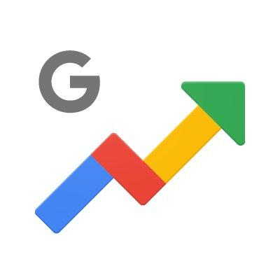


Data Sources
Data Sources
Pytrends-4.7.2
Notes:
For games we use VGChartz, and movies we use IMDB. PyTrends API for Google Trends

Slide 5
Methodology
Scrape Websites for Sales/Reviews Data
Use Pytrends API for Google Trends data
Data Cleaning and Sorting
Data Visualization and Analysis
Notes:
Multiple keywords query, Google trends performs normalization depending on the topmost search volume Pytrends only searches 5, we changed it to get any number of results with proper normalization.
Related keyword searches, remove special characters, etc

Slide 6
Game Sales
VS
Google Trends

Slide 7
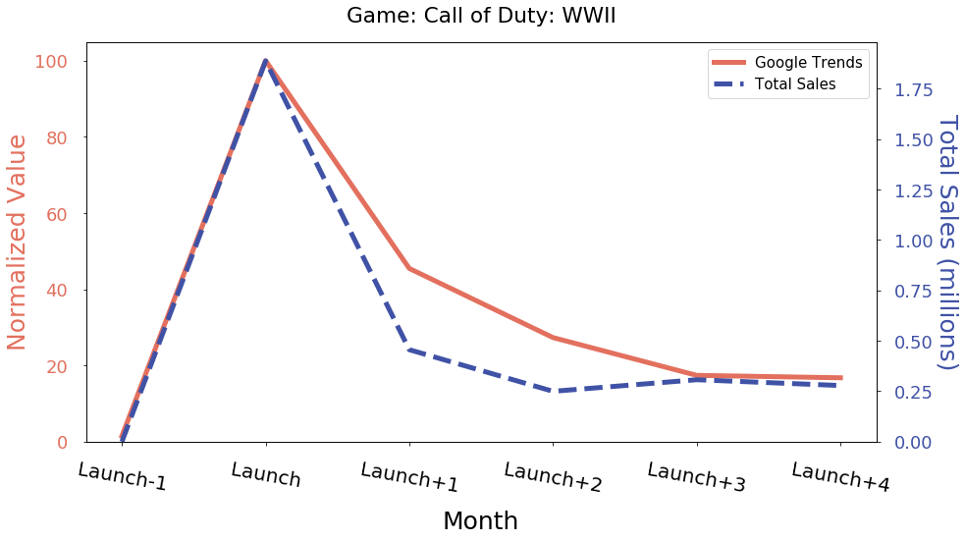
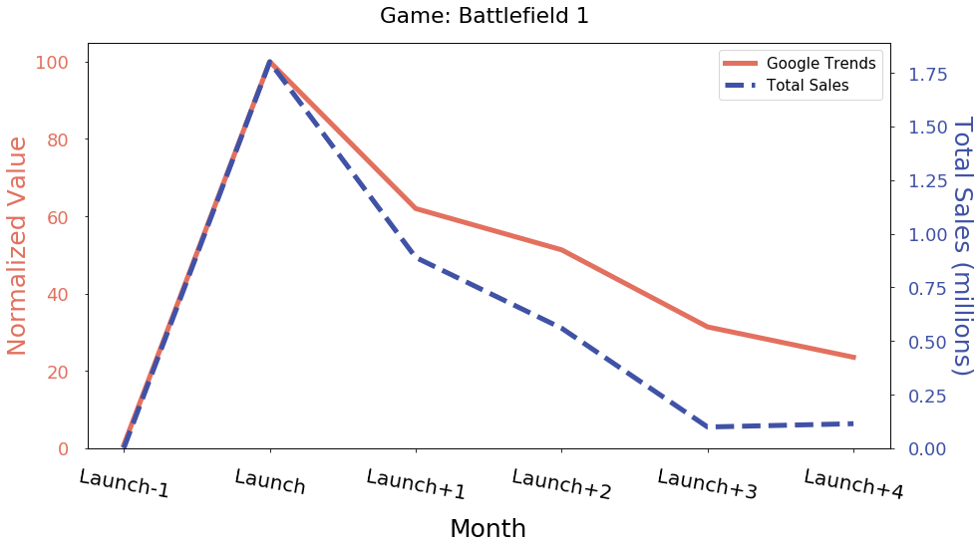
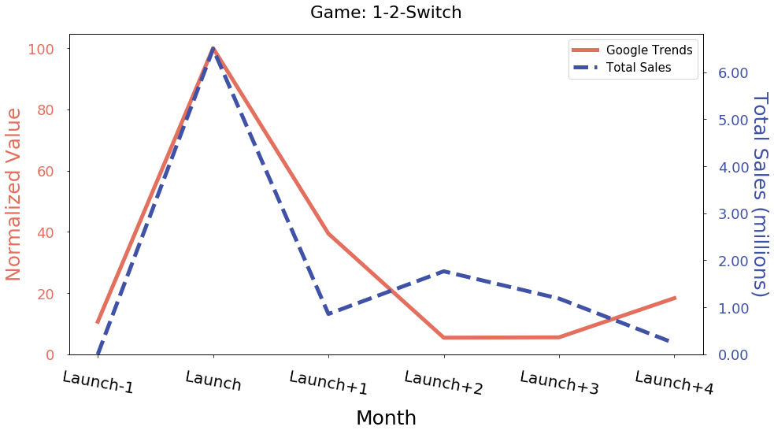
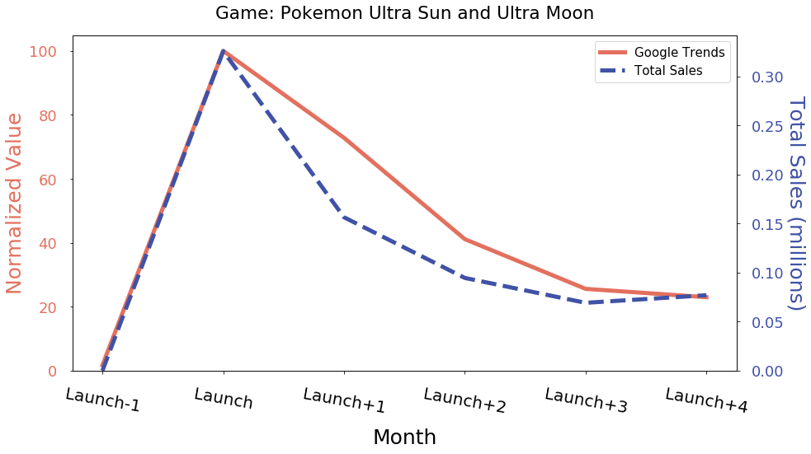
Video Games
Trends Comparison over Launch Period
Notes:
Our first real world data is the global sale of video games. We compared monthly game sales and normalized google search volume around the launch period from one month before launch to 4 months after launch.
At the launch month, both google search volume and total sales reach their peak, followed by a decrease in both data. Interstingly, the decreasing rate of both data are similar to each other although they are from completely different resources. Similar patterns are observed for the other three games and many others not listed here
It tells us that the google search volume can reflect the in-time global sale status.

Slide 8
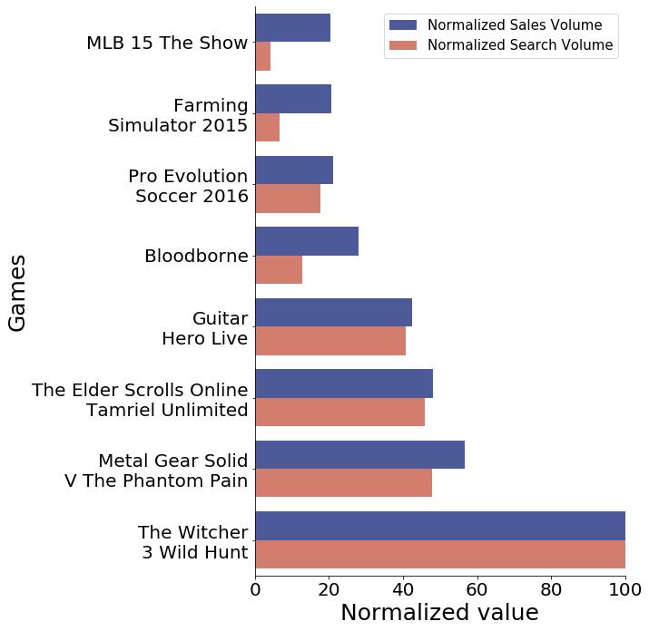

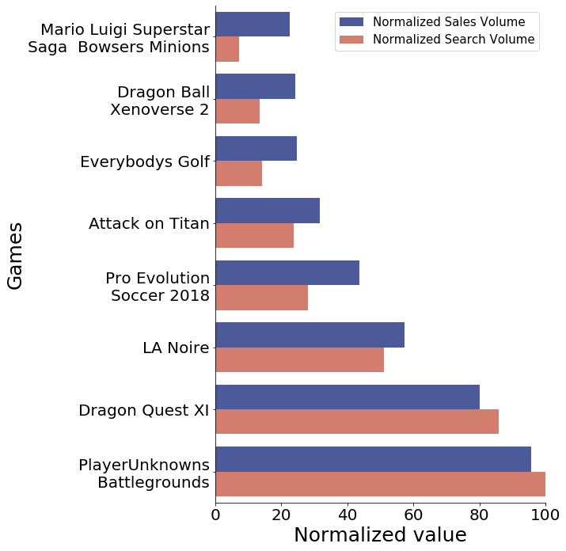

Top Games by Year
Year: 2015
Year: 2017
Notes:
Furthermore, these are the Top 8 games released in 2015. The blue bar is the Total Sales and the red bar is the Total Search Volume of the games.
The trend is obvious. In most cases, games with higher search volume earn more money.

Slide 9

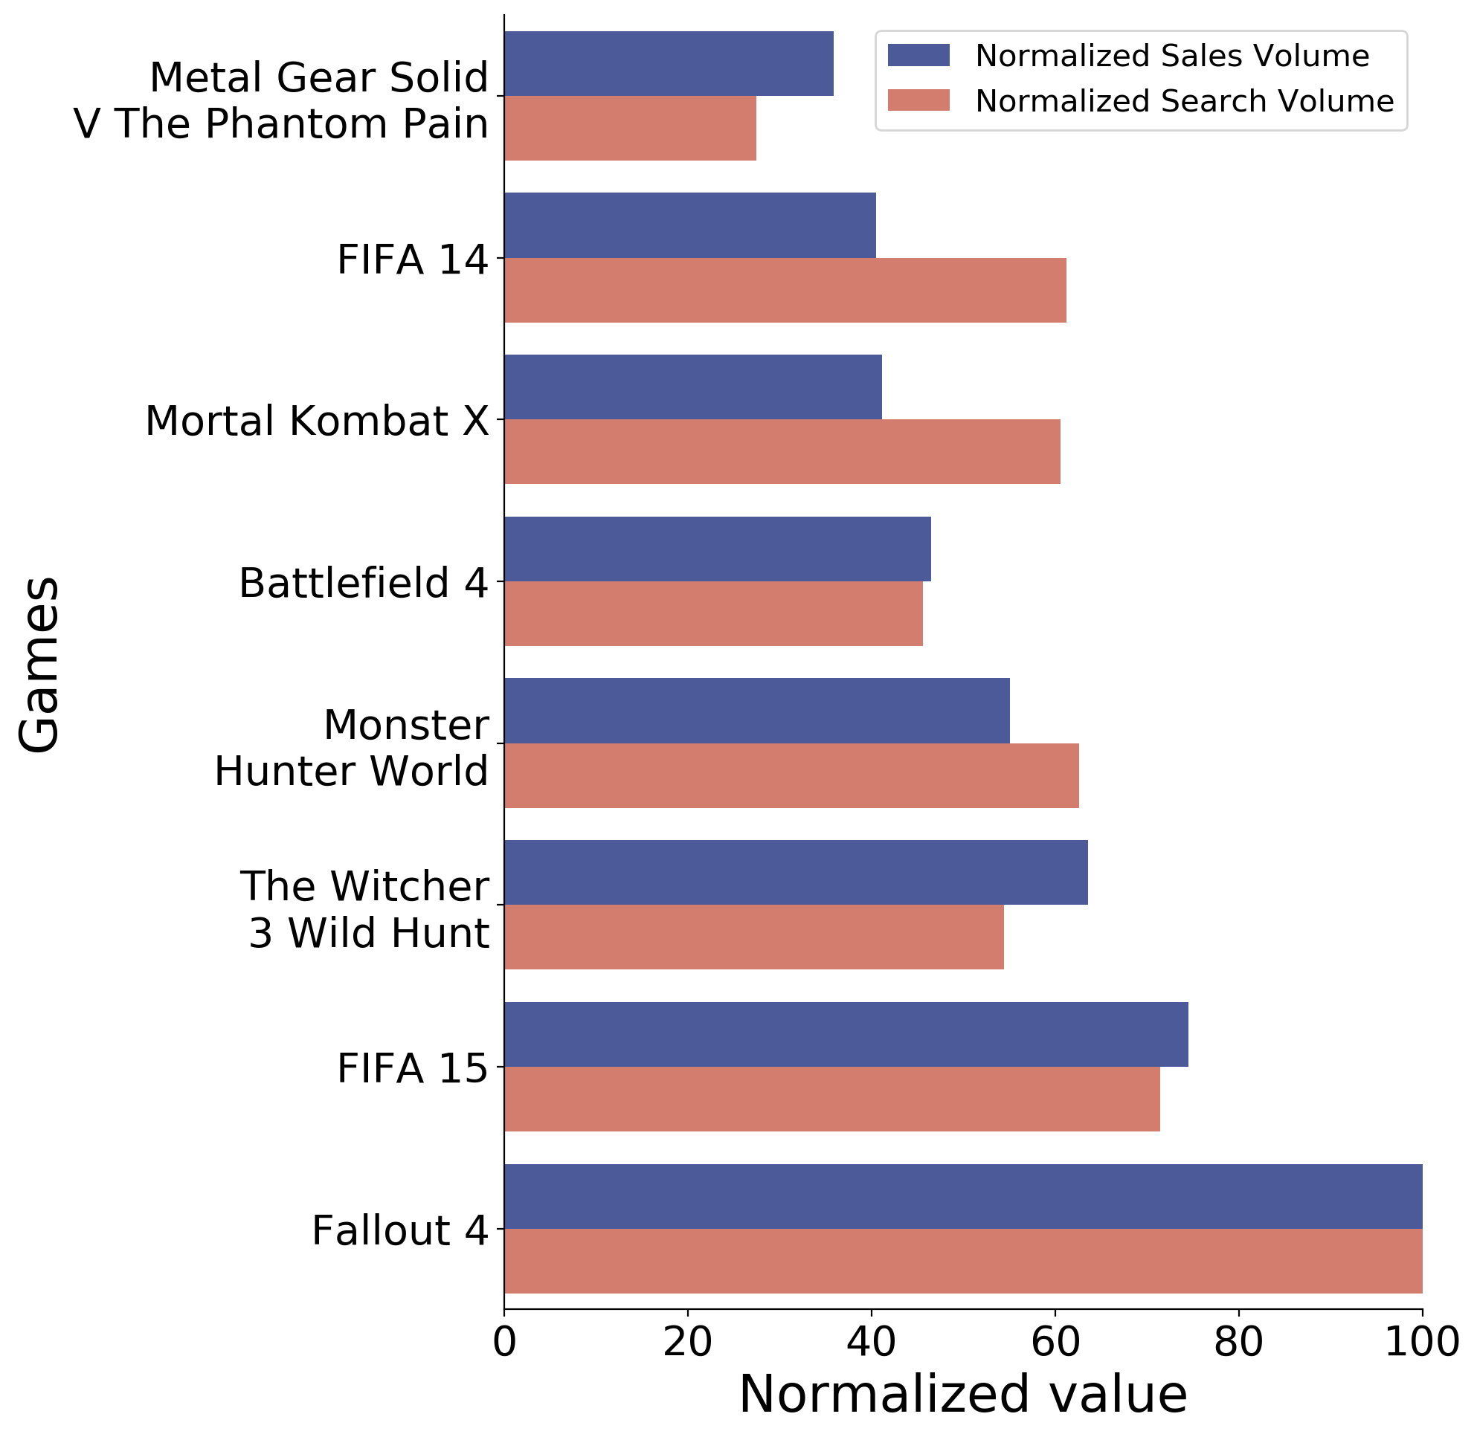
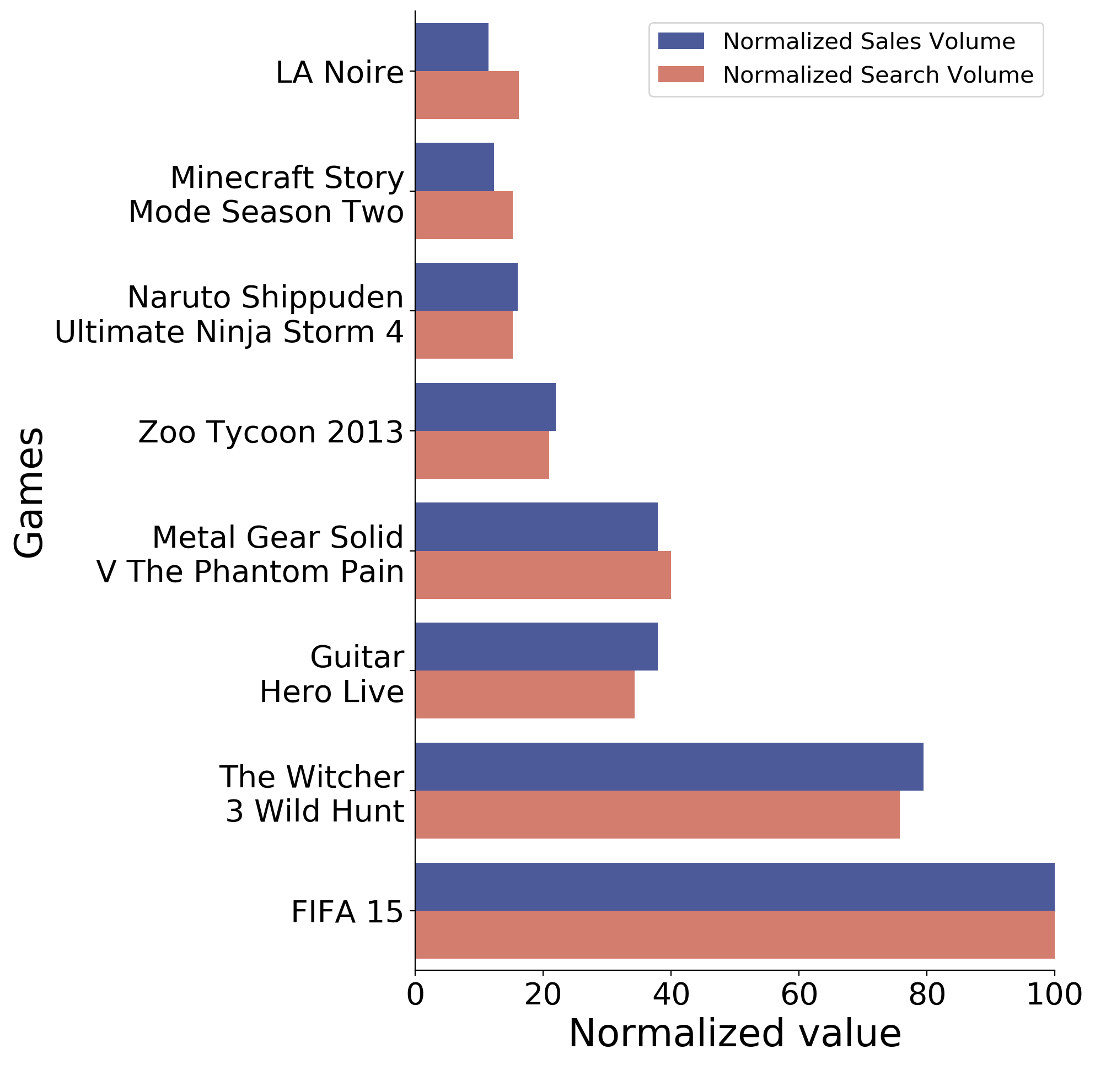
Top Games by Platform
PS4
Xbox One
Notes:
And we analyzed Top 8 games on different platforms, for example, PS4 and Xbox One.
The trend and patterns are very similar to last comparison, within each platform, games with higher search volume earn more money.

Slide 10
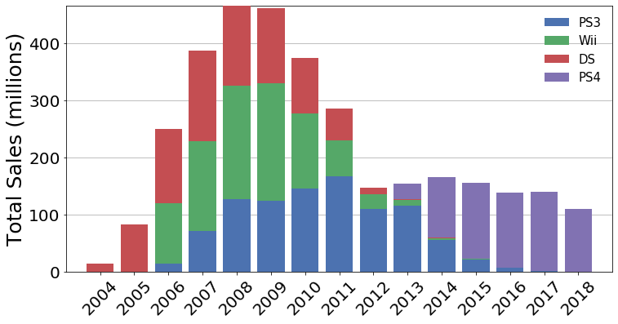
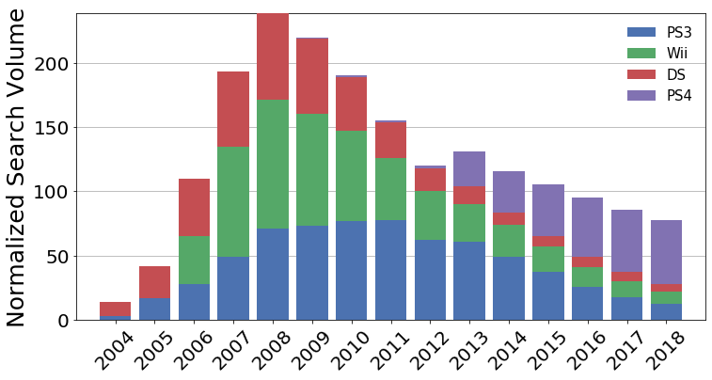
Platforms over Time
Sales
Google Trends
Notes:
We now analyze the Total Sales of all the games from selected platforms from 2004 to 2018.
The peak total sale of these platforms occured in 2008. Interestingly, the corresponding google search volume also peaked in the same year.
The mainstream platforms are changing over time. PS4 was released in 2013 and the market changed totally after that. People abandoned old games, and started to search ‘PS4’ and buy PS4 games. The google trend data shows a new era begins in 2013, and PS4 did make a lot of money at that time.
All these comparison show google trends tells us the market interest and popularity of game industry

Slide 11
Movie Sales
VS
Google Trends

Slide 12
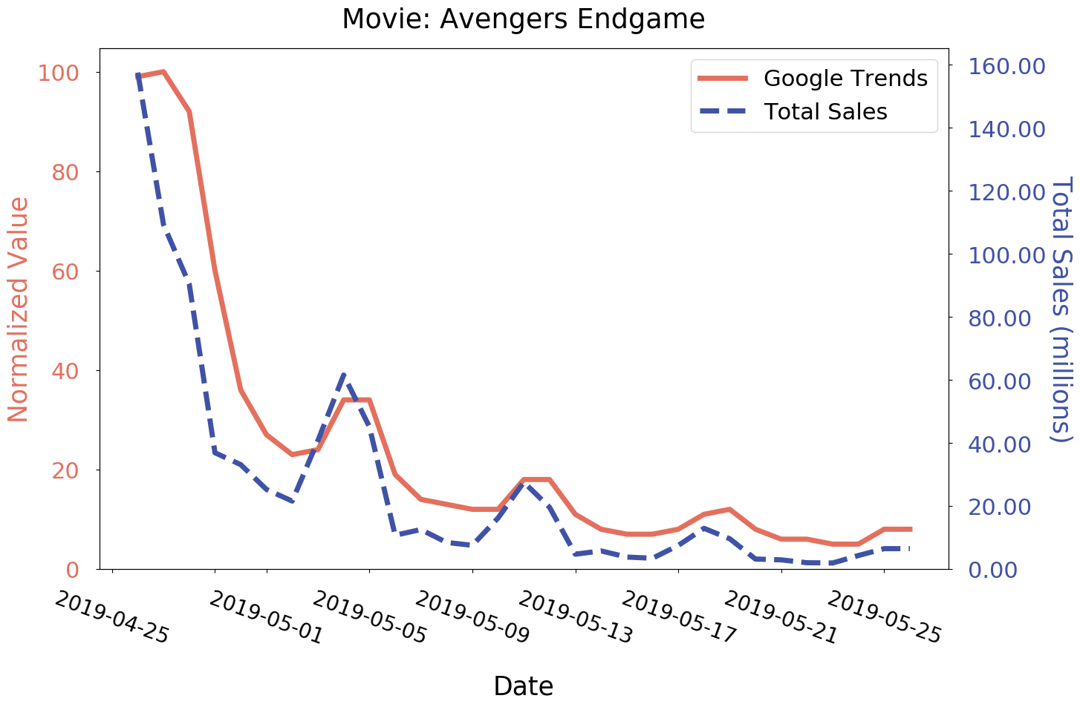
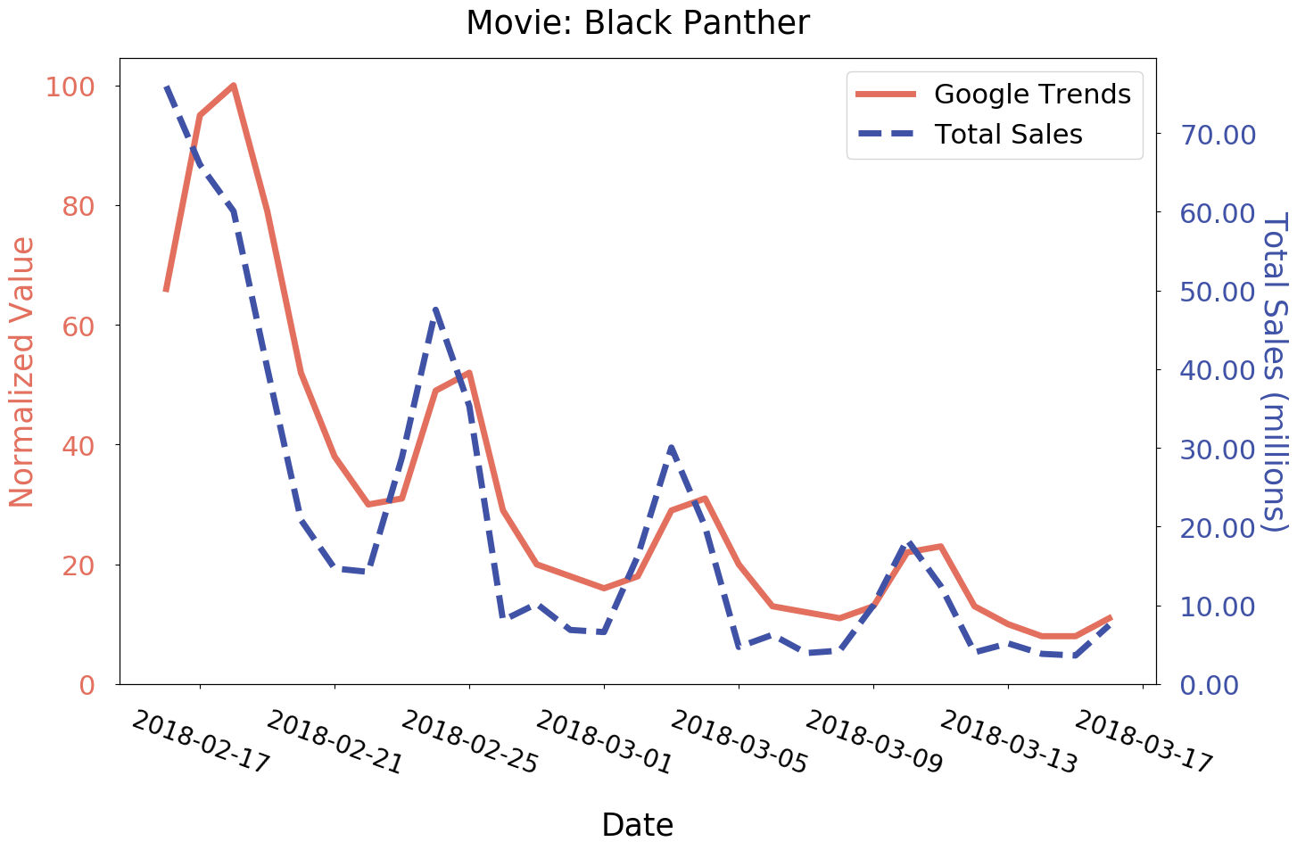
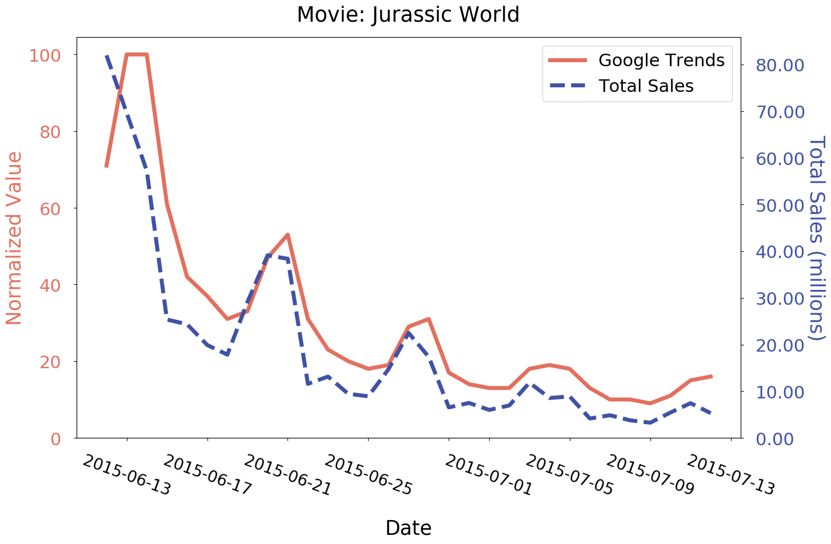
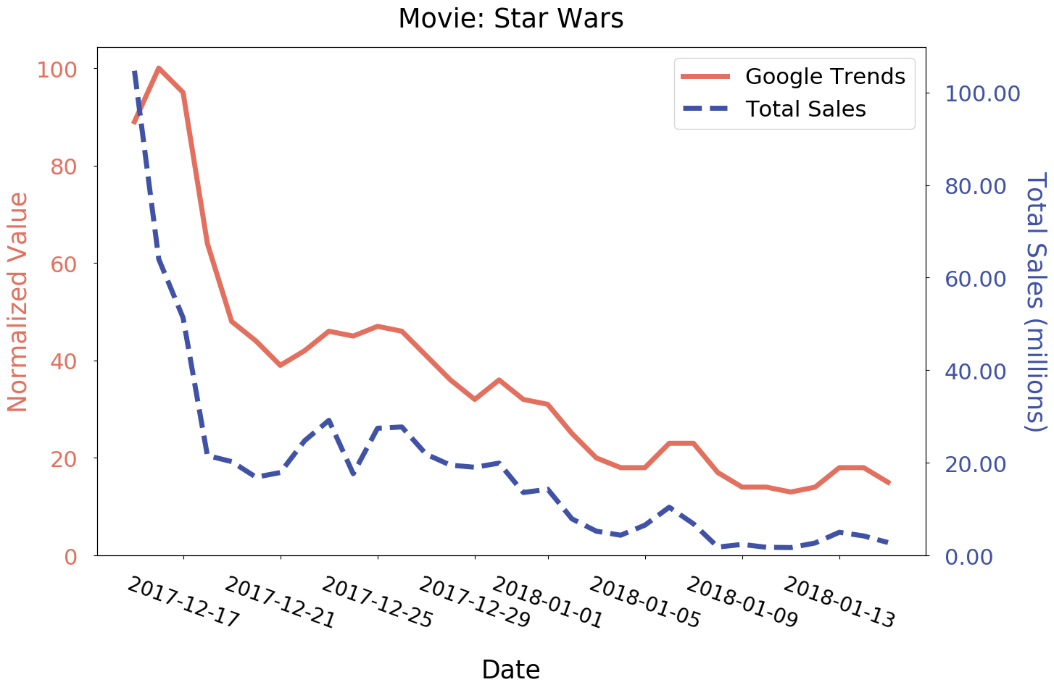
Individual Movies vs Search Trends
Notes:
We see peeks at some distance - weekend data - people search more on weekends and book tickets

Slide 13
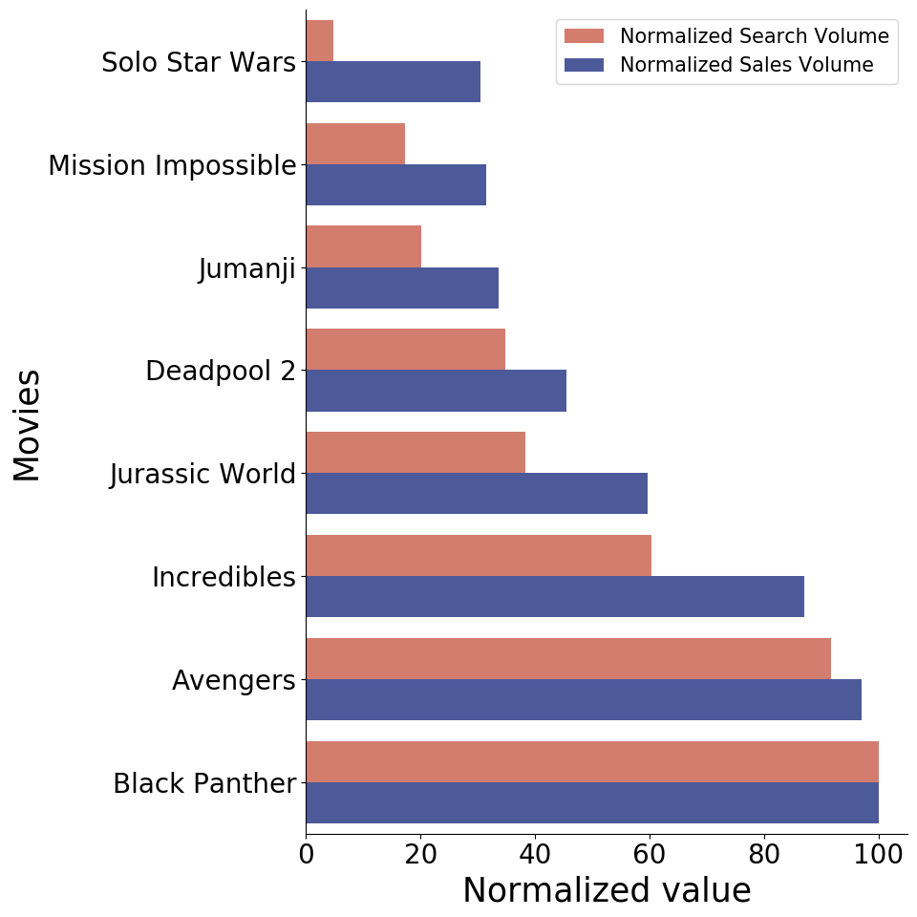
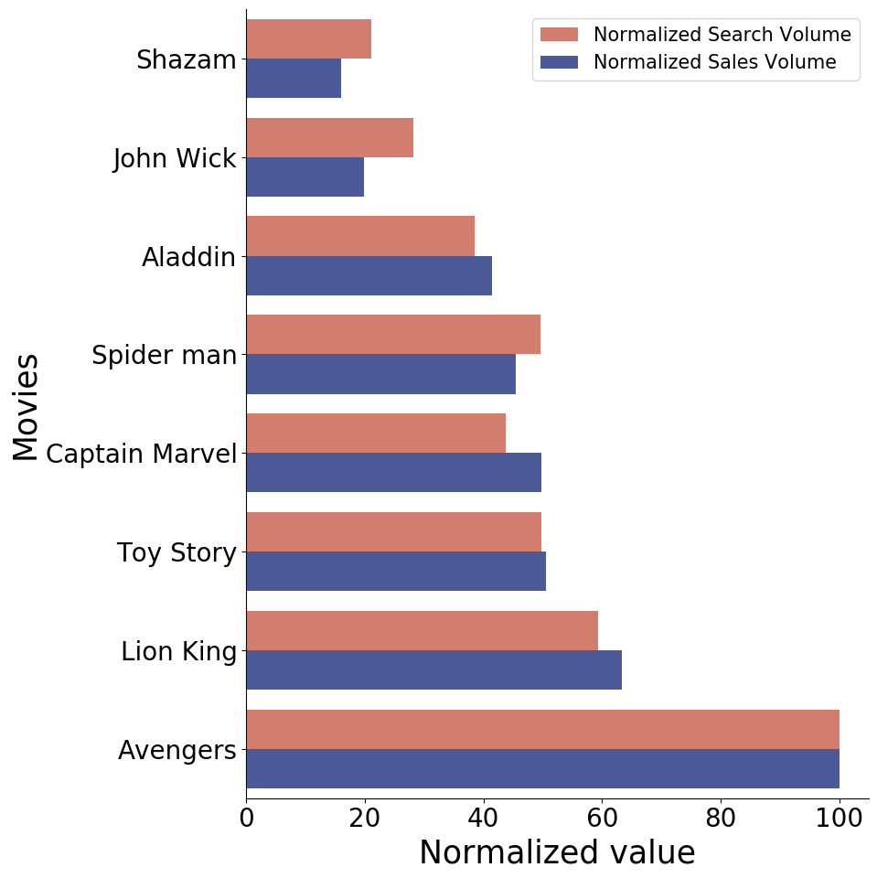
Top Movies by Year
Year: 2018
Year: 2019

Slide 14
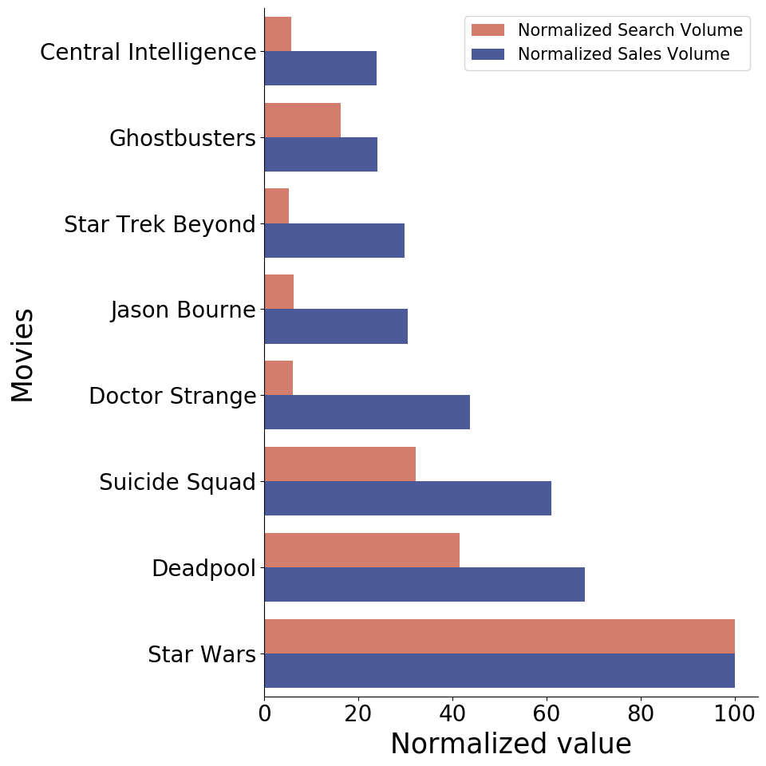
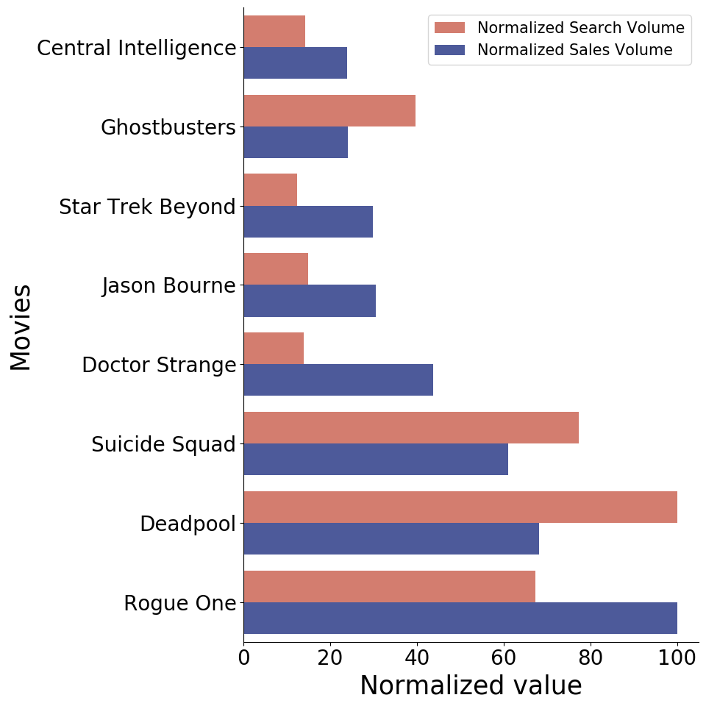
Top Action Movies
Default Search
Improved Search
Notes:
Instead of directly searching the movie name, we also search the related keywords, to obtain better info. Rogue One is Star Wars franchise.

Slide 15
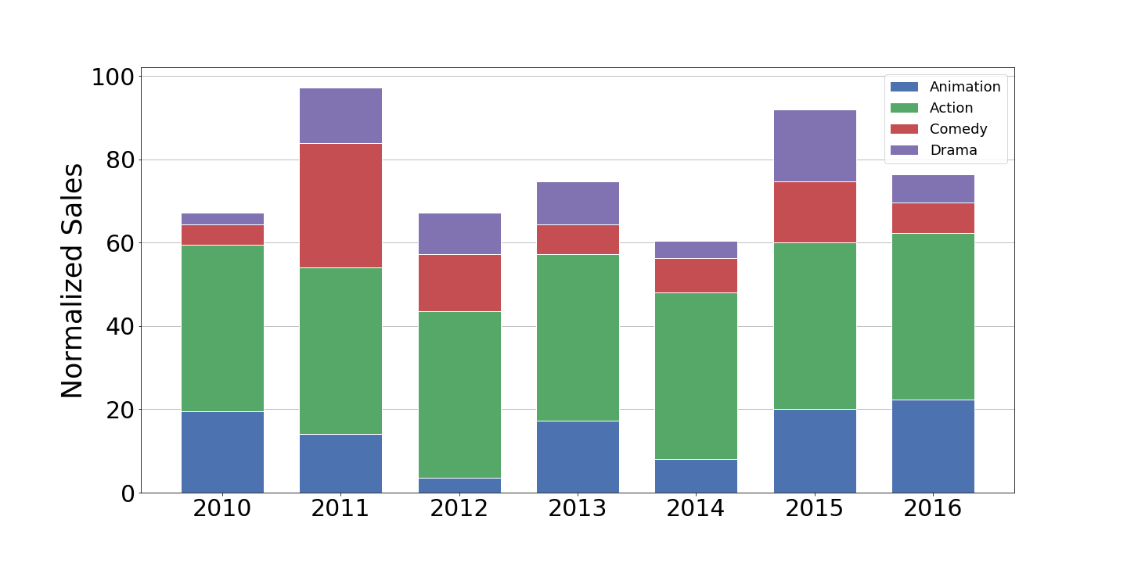
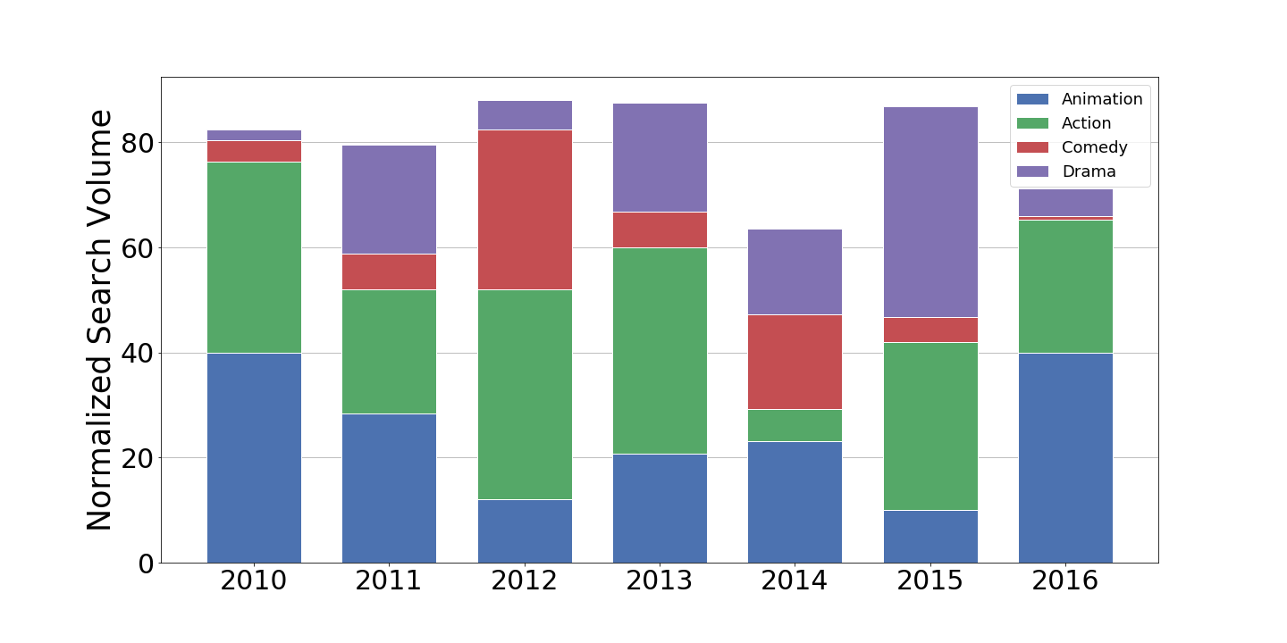
Movie Sales per Genre vs Trends
Sales
Google Trends
Notes:
Accumulated results from top (20) movies for each genre
Action: Popular throughout - Trends also show they are popular Animation: Follows the trend nicely for both For others as well, the trend follows - eg. Drama we see it reduces from 2013 to 2014 and increased in 2015...

Slide 16
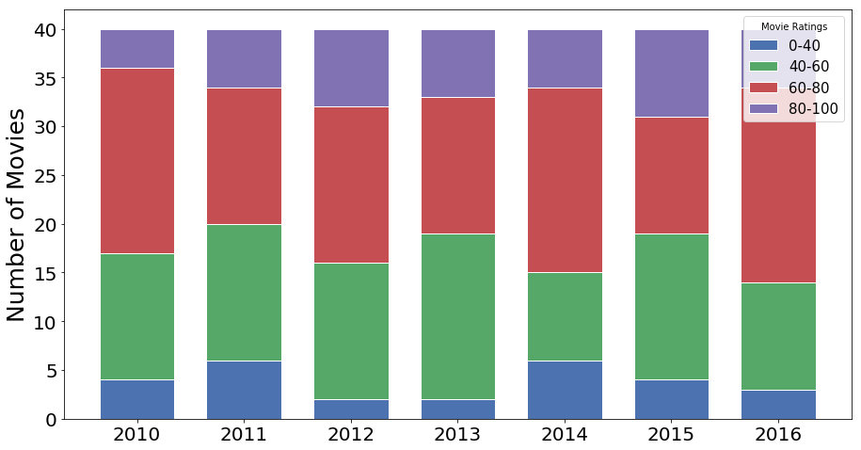
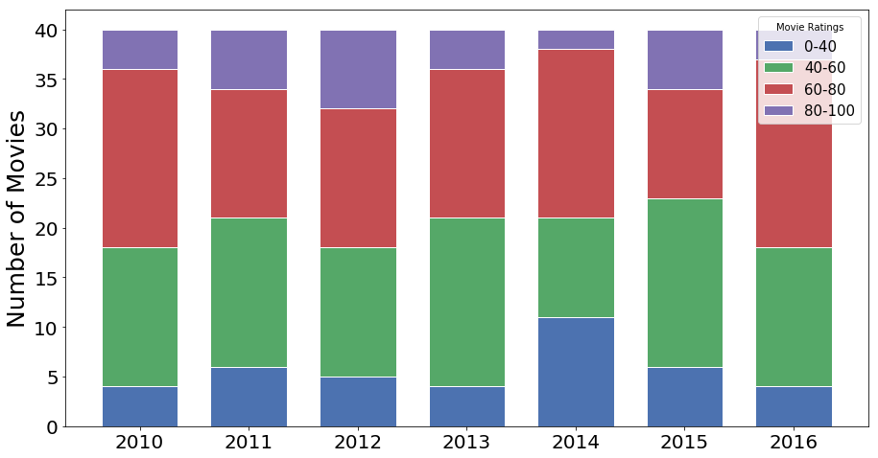
Movie Ratings vs Trends
Sales
Google Trends
Notes:
This graph shows top 40 movies according to popularity, grouped by ratings
This graph shows top 40 movies according to revenue, grouped by ratings
Strong correlation between the two - sales vs popularity - majority movies in both are in 4-6 and 6-8 range This also shows that Ratings cannot be predicted by Google Trends, and they do not have string correlation on sales as well.

Slide 17
Summary
Correlates to real-world data
Can be used in place of real-world data
Applicable to a wide variety of topics
Notes:
Meaningful insight about popularity; over a large range of time and features
Can be used where real world data is expensive/difficult to collect
Such as voter turnout, stock prices. Can help companies for effective marketing

Slide 18
Thank You

